Slide 1
IBM University Engagement Project Submission
“Exploring the Power of Agentic AI with IBM Granite and LangFlow”

Slide 2

Project Tile – [SOCIAL MEDIA AGENT]
Domain of Project – [ SOCIAL MEDIA AND DIGITAL MARKETING ]
Student Name | Recent Passport Photo | Email ID | Mobile number [WhatsApp]
ARYAN YADAV |  | yadavaryan11595@gmail.com | 9699800397

Slide 3
Problem Statement -
Brands, influencers, businesses, and organizations struggle to keep up with the fast-paced and ever-changing world of social media. Trends evolve rapidly, audience preferences shift frequently, and competitor strategies change continuously across multiple platforms such as Instagram, Facebook, LinkedIn, and X (Twitter). Managing content, analyzing audience sentiment, tracking competitors, and maintaining engagement across different platforms is time-consuming and inefficient. The challenge is to build an intelligent system that not only collects and analyzes social media data but also predicts trends, generates content, and recommends actions in real time to maximize engagement and campaign performance.
Objectives
The objective is to build an Agentic AI-powered Social Media Agent that acts as an intelligent social media companion for brands, marketers, influencers, and organizations. The solution should:
1. Fuse Multi-Platform Social Media Data
Collect and integrate posts, comments, hashtags, engagement metrics, and competitor activities from platforms such as Instagram, Facebook, LinkedIn, and X into a unified analytics system.
2. Enable Multimodal Interaction
Allow users to interact using text, voice, or image inputs to generate captions, social media posts, campaign ideas, hashtags, and creative content while maintaining the brand's tone and style.
3. Create a Predictive & Agentic Layer
Analyze audience behavior, forecast trending topics and hashtags, predict engagement performance, identify competitor strategies, and recommend the best posting times and content strategies.
4. Visualize Social Media Insights
Provide an interactive dashboard with real-time analytics, including engagement trends, audience sentiment, influencer analysis, competitor comparisons, campaign performance, and AI-powered recommendations.
5. Automate Social Media Management
Enable intelligent scheduling, content recommendations, campaign planning, performance monitoring, and automated responses to improve productivity and audience engagement.

Slide 4
Proposed Solution -
Proposed Solution: SOCIAL MEDIA AGENT
The proposed solution is a multi-agent AI-powered SOCIAL MEDIA built using IBM LangFlow, IBM watsonx.ai, IBM Orchestrate, and Granite Models to provide personalized, real-time travel planning and intelligent trip assistance. The system addresses challenges in trip planning, booking management, itinerary optimization, and real-time travel support through an intelligent, modular architecture.
:
SOCIAL MEDIA
Retrieves and summarizes destination information, tourist attractions, transportation options, accommodation details, and local events using the RAG pipeline to help users plan complete trips.
Itinerary Recommendation Agent
Generates personalized travel itineraries based on user inputs such as destination, budget, travel dates, interests, group size, and preferred activities. It recommends optimized routes, attractions, hotels, restaurants, and transportation options.
DIGITAL MARKETING
Provides predictive travel insights by monitoring weather forecasts, flight delays, traffic conditions, hotel price trends, and crowd levels. It proactively suggests alternative routes, travel schedules, and booking opportunities to ensure a smooth travel experience.
Allows users to search and manage flights, hotels, local transport, and activity bookings using text, voice, or image inputs. It also provides real-time notifications, travel reminders, navigation assistance, and instant recommendations throughout the journey.
The solution includes a user-friendly dashboard (built with React or Streamlit) that visualizes trip itineraries, booking status, travel expenses, weather forecasts, maps, nearby attractions, travel alerts, and personalized recommendations in real time.
IBM LangFlow is used to orchestrate the workflows between multiple AI agents, while IBM Orchestrate automates travel-related tasks such as searching, booking, itinerary updates, and notifications. IBM watsonx.ai provides scalable AI model deployment, embeddings, and governance, while IBM Granite Models power reasoning, itinerary generation, travel recommendations, summarization, multilingual interactions, and intelligent decision-making.
Overall, this solution delivers an end-to-end intelligent travel assistant that simplifies travel planning, personalizes every journey, automates bookings, provides proactive travel support, and enhances the overall travel experience through real-time insights and AI-powered recommendations.

Slide 5
Technology Used
Langflow platform -For designing and orchestrating multi-agent workflows visually
IBM Granite model - for eg – ibm-granite-3-2-8b – For natural language understanding, reasoning, and personalization
IBM Cloud – It provides the infrastructure to build, deploy, and scale the Nutrition Agent efficiently. IBM Cloud enables a reliable, secure, and scalable environment for deploying the Nutrition Agent.
RAG– RAG to fetch real data first, then generate intelligent answers, making the Nutrition Agent more trustworthy and effective.
IBM Watsonx.ai - For model deployment, embeddings, and AI governance
Vector Database (FAISS/Chroma) – For RAG-based nutritional data retrieval

Slide 6
Langflow component Used -
1) Chat Input – Interface where users enter their queries, preferences, or meal details (text/voice/image).
2) IBM watsonx AI Agent - Processes user input using Granite models to generate personalized nutrition insights and recommendations.
3) Name of IBM Granite model - Granite-4.0-8B-Instruct → Fast, efficient for real-time diet recommendations
4) Chat output -Displays AI-generated responses such as diet plans, nutritional analysis, and health suggestions.
5) File component - Stores and retrieves user data, meal logs, and nutritional datasets for analysis and tracking.
6) Add name of any other component used.

Slide 7
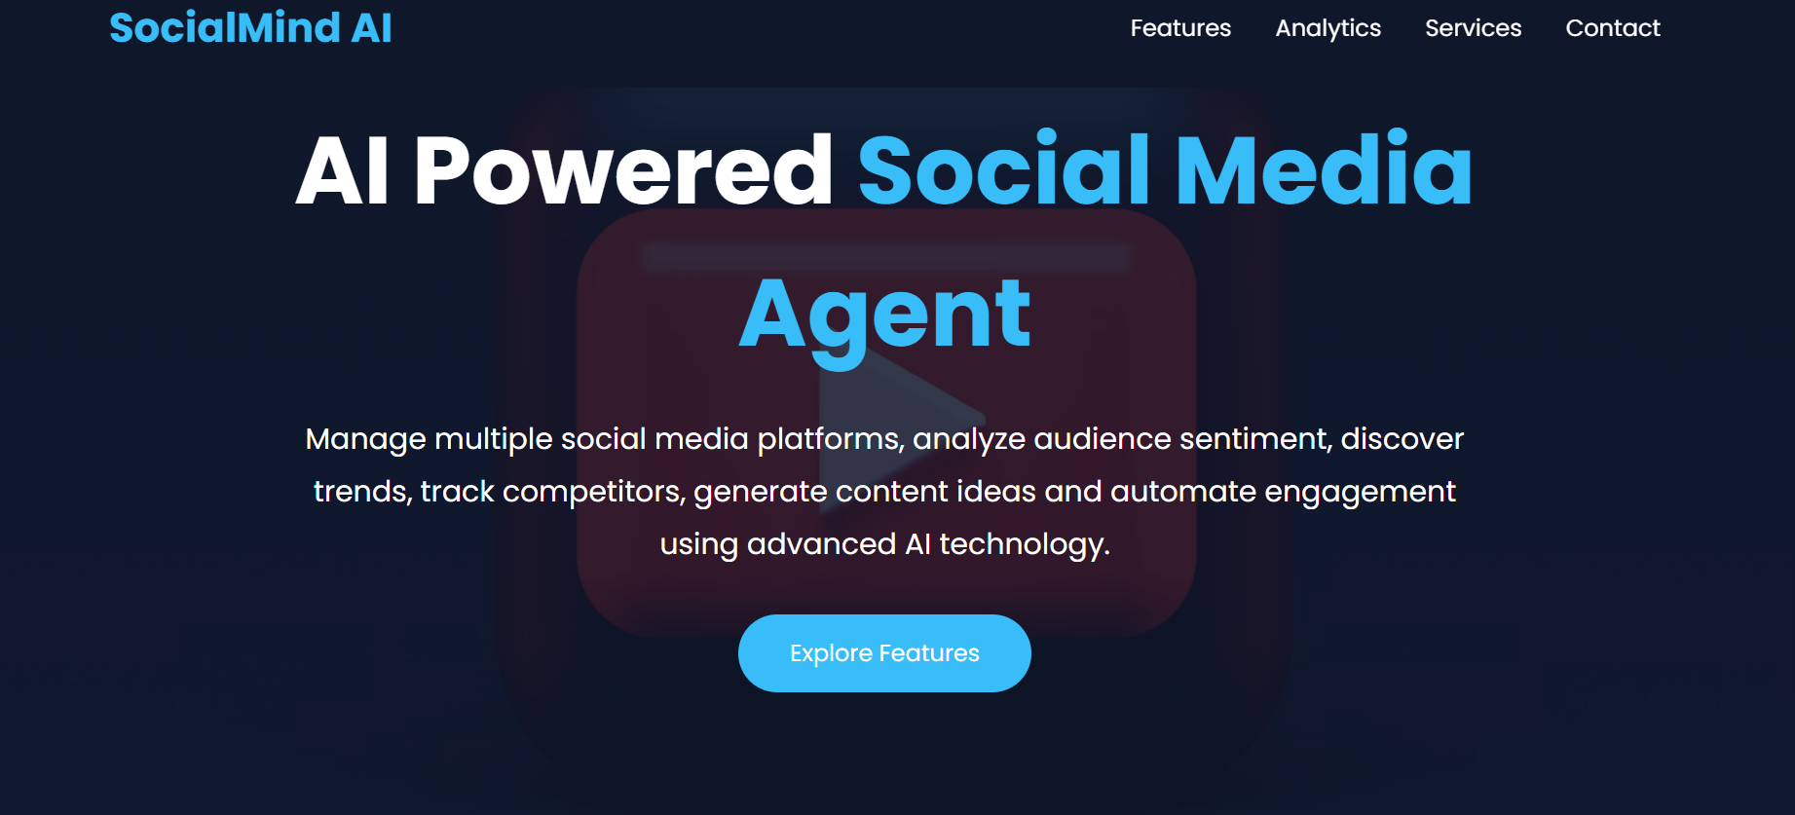
WEBSITE PAGE

Slide 8
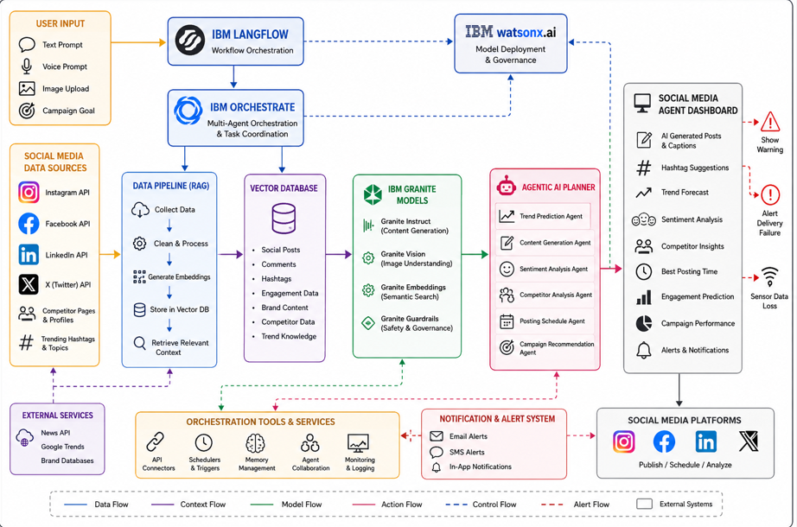
Architecture blueprint

Slide 9

Role of Agentic AI in the solution
Agentic AI transforms the Social Media Agent from a simple automation tool into an intelligent, autonomous system capable of planning, reasoning, and executing tasks with minimal human intervention. Instead of only responding to commands, it proactively analyzes data, makes decisions, coordinates multiple AI agents, and continuously optimizes social media strategies.
In the proposed solution, the Social Media Agent is powered by multiple specialized AI agents that collaborate to perform different tasks:
Content Generation Agent – Creates engaging captions, posts, blogs, and hashtags tailored to the target audience and platform.
Trend Analysis Agent – Monitors trending topics, hashtags, and viral content to recommend timely marketing opportunities.
Sentiment Analysis Agent – Analyzes comments, reviews, and messages to determine audience sentiment (positive, negative, or neutral) and provide actionable insights.
Scheduling Agent – Automatically schedules and publishes content at optimal times based on audience activity and engagement patterns.
Analytics Agent – Tracks key performance indicators (KPIs) such as reach, impressions, engagement rate, click-through rate, and follower growth, generating comprehensive performance reports.
Competitor Analysis Agent – Monitors competitor activities, identifies successful strategies, and suggests improvements to maintain a competitive advantage.
Customer Engagement Agent – Responds to frequently asked questions, interacts with followers, and escalates complex queries to human managers when necessary.

Slide 10


Token Usage
11,761 token are used
Before Prompt
After the Prompt
·
·
·

Slide 11
Novelty and Uniqueness
The proposed Nutrition Agent stands out by combining Agentic AI, RAG, and personalization into a single intelligent system.
Multi-Agent Intelligence – Instead of a single chatbot, multiple specialized agents collaborate to deliver accurate and context-aware nutrition guidance.
RAG-Based Accuracy – Integrates real-time data retrieval with AI generation, reducing misinformation and ensuring trustworthy recommendations.
Hyper-Personalization – Tailors diet plans based on health conditions, cultural preferences, and fitness goals.
Real-Time Feedback Loop – Continuously adapts recommendations based on daily food logs and user behavior.
Multi-Modal Input – Supports text, voice, and image-based meal tracking for better usability.
Preventive Healthcare Focus – Goes beyond diet planning to provide disease-specific nutrition advice.
Scalable & Enterprise-Ready – Built on IBM watsonx.ai with IBM Granite models, ensuring reliability and governance.
This makes the solution a smart, adaptive, and proactive digital nutritionist, not just a static diet recommendation tool.

Slide 12
Git Hub Link
Please create public github repository (Enable Add README button while creating repository) with format –
Please test and Paste the working Github URL –https://github.com/yadavaryan11595-rgb/IBM-WORKSHOP.git
Make sure you have Uploaded following three files into your github repository 1) app.json file , 2) yourproblemstatement.pdf file 3) your projectpresntation.pptx file 4)any other files
·
·
·

Slide 13
Future Scope
The AI-Powered Social Media Agent can be further enhanced with advanced capabilities to provide a smarter, more automated, and highly personalized social media management experience. Some future enhancements include:
AI-Based Automatic Content Publishing: Enable the agent to automatically schedule and publish posts across multiple social media platforms based on user approval and optimal engagement times.
Advanced Video & Reel Generation: Integrate AI-powered video creation to generate short videos, reels, stories, and promotional content from text prompts or images.
Influencer Collaboration Engine: Recommend suitable influencers based on audience demographics, engagement rates, niche, and campaign objectives for effective brand collaborations.
Real-Time Trend Prediction: Continuously monitor global and regional social media trends, viral hashtags, and emerging topics to recommend timely content strategies.
Multilingual Content Generation: Generate and translate posts, captions, hashtags, and replies into multiple languages, enabling brands to reach global audiences.
AI-Powered Community Management: Automatically respond to comments, direct messages, and customer queries while maintaining the brand's tone and ensuring high engagement.
Competitor Intelligence: Provide deeper competitor analysis by tracking campaign performance, posting frequency, audience growth, engagement metrics, and content strategies.
Sentiment & Crisis Detection: Detect negative sentiment, misinformation, or potential PR crises in real time and recommend proactive actions to protect brand reputation.
Predictive Campaign Analytics: Forecast campaign reach, engagement, conversion rates, and ROI before publishing, helping marketers optimize their strategies.
Personalized Marketing Recommendations: Learn user preferences and audience behavior over time to suggest customized content ideas, posting schedules, and marketing strategies.
·
·
·

Slide 14
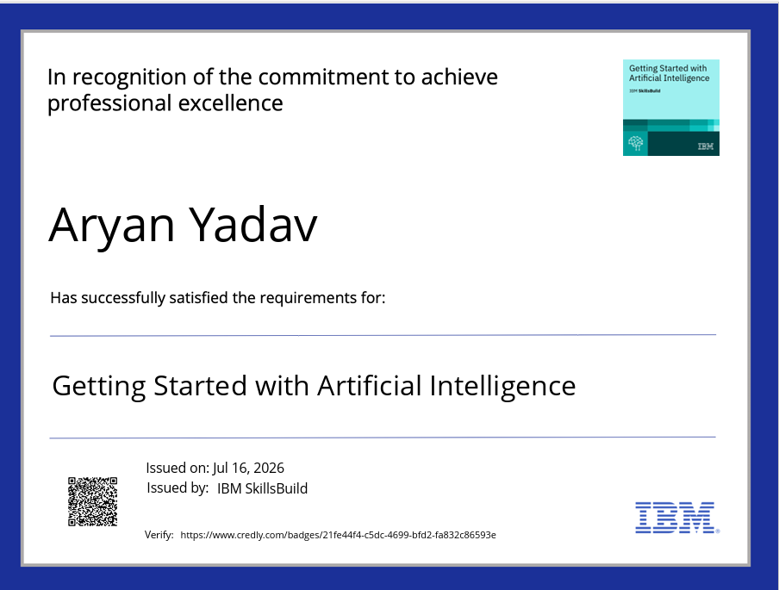
Certificates Earned:
Please add your credly certificate

Slide 15
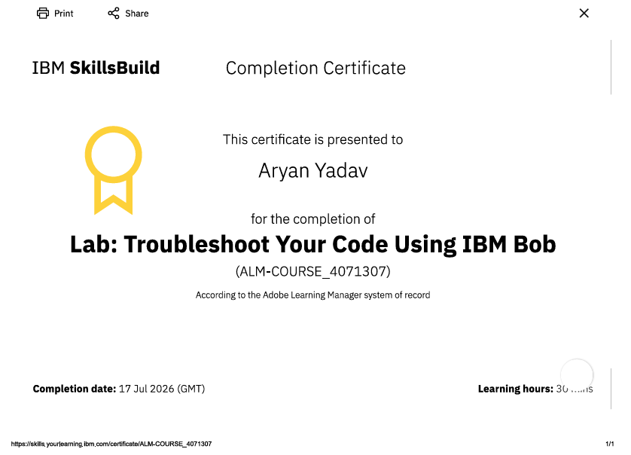
Certificates Earned:​
Add your IBM BOB Certificate

Slide 16


